Slide 1
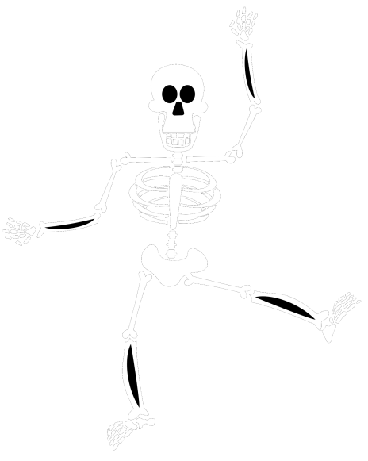
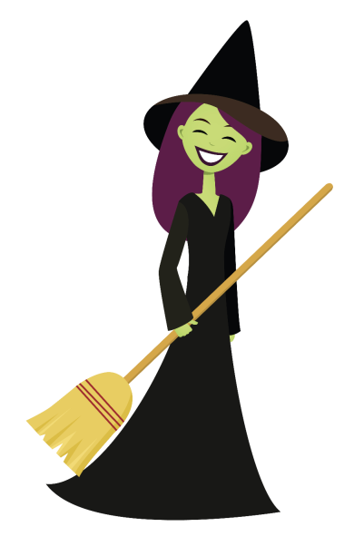
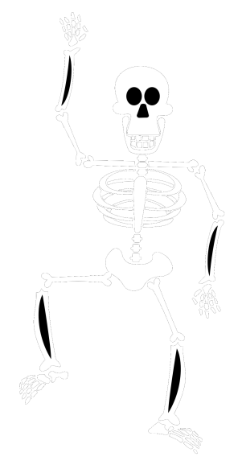
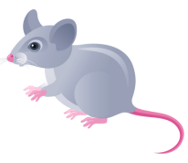
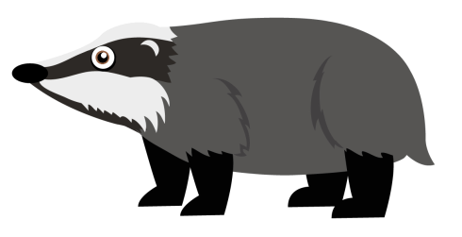
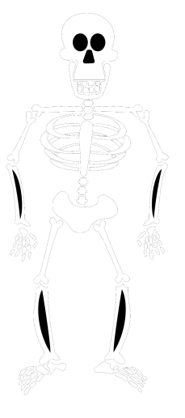
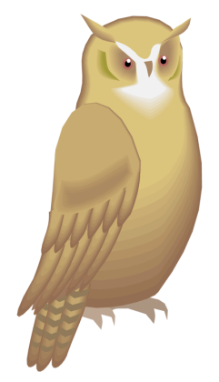
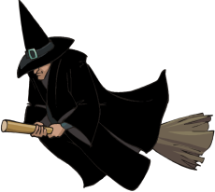
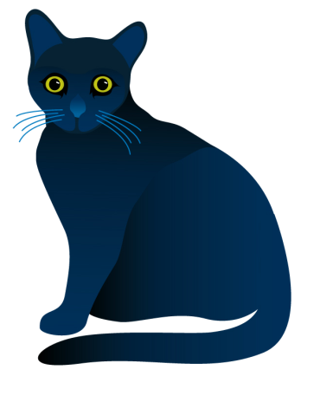
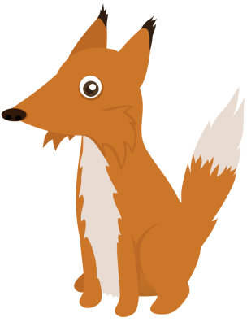
Choose your characters and drag them onto the slide
Winnie and Whiskers Halloween Adventure
Story by Primary 2

Slide 2
Choose your characters and drag them onto the slide
In the dark, dark forest, on Halloween night, Willow the witch stood in front of the huge full moon.
Beside her sat her best friend, Whiskers the cat.

Slide 3
Choose your characters and drag them onto the slide
Willow wore a black, shiny, pointed hat and a long black dress. She had ghastly green skin and long violet hair. In her hand she carried her broomstick!
Whiskers the cat is Willow’s sidekick. He is as black as the night to help him hide in the shadows!

Slide 4
Choose your characters and drag them onto the slide
Willow was searching for her cauldron – she didn’t know where it could be! She had hidden it in the forest last Halloween and she wanted to make a special potion.
So she waved her wand and said “Cauldron, Cauldron come back to me.
Where on Earth could you possibly be?”
But…nothing happened!
So, she whispered the most magical word of all…
“PLEASE!”

Slide 5
Choose your characters and drag them onto the slide
Suddenly, her cauldron zoomed into view…

Slide 6
Choose your characters and drag them onto the slide
Willow was a lonely witch. Her only friend was Whiskers. She wanted some friends to celebrate Halloween with - but she needed to use magic to make it happen.
She decided to cast a magical spell. She sent Whiskers off into the forest to find some woodland creatures to add to the potion!
“Bring me what I need to make my potion Whiskers” she said.

Slide 7
Choose your characters and drag them onto the slide
Whiskers returned with an owl, a fox, a hedgehog, a badger, a rat and a bat.

Slide 8
Choose your characters and drag them onto the slide
“Great job Whiskers, "said Willow. “These will be perfect for my potion!
We will make some friends for us! We just one last thing. Get me a skeleton bone!” she said.

Slide 9
Choose your characters and drag them onto the slide
So Whiskers disappeared into the darkness and Willow got to work on her potion.

Slide 10
Choose your characters and drag them onto the slide
Feather of owl,
Tail of rat,
Badger’s nose
And wing of bat
Ear of fox
Hedgehog spikes
Make me some new friends when midnight strikes!

Slide 11
Choose your characters and drag them onto the slide
Nothing happened… “I must have forgotten something important!” said Willow.
Just then Whiskers appeared carrying the skeleton bone. He added it the potion.
Willow wailed “Magical bone, magical bone, now I will never be ALONE!”

Slide 12
Suddenly from the cauldron appeared…
One skeleton, two skeletons… three skeletons!
Choose your characters and drag them onto the slide

Slide 13
Choose your characters and drag them onto the slide
The skeletons were so friendly.
The first was called Skelly, the second was called Skulls and the third one was called Bones!

Slide 14
Willow and Whiskers danced all night with the skeletons!
They laughed and told ghost stories.
Willow had a great night with her new friends!

Slide 15
When the party was over the three skeletons disappeared into the forest.
Willow was tired and ready to go home.
She jumped on her broom stick.

Slide 16
As she zoomed past the moon she shouted “Goodbye skeletons, see you next Halloween!”
And she was never lonely again!

Slide 17
Write your sentence here
Choose your characters and drag them onto the slide

Slide 18
Write your sentence here
Choose your characters and drag them onto the slide

Slide 19
Write your sentence here
Choose your characters and drag them onto the slide

Slide 20
Write your sentence here
Choose your characters and drag them onto the slide

Slide 21
Write your sentence here
Choose your characters and drag them onto the slide

Slide 22
Write your sentence here
Choose your characters and drag them onto the slide

Slide 23
Choose your characters and drag them onto the slide
The End

